Slide 1

Software Engineering lecturer: Professor Damir Dobric
Test and Investigation of Video Learning
Presented by: Khaled Kandil & Tuan Nghia Nguyen

Slide 2
Outline
Introduction
Methods
Results
Discussions

Slide 3
Introduction
Video learning is being widely used on applications like inspection, surveillance, process management and quality control, where a lot of manpower is required to assess the footage. Artificial Intelligence is used to reduce the workload in the video analysis while increasing the accuracy in tasks such as detection and classification.
The algorithms use statistics to find patterns in data from small to massive amounts.

Slide 4
Methods
The project contains set of libraries for NeoCortex API which focuses on implementation of Hierarchical Temporal Memory Cortical Learning Algorithm.
The project includes the Spatial Pooler, Temporal Pooler, various encoders and CorticalNetwork algorithms.

Slide 5
Temporal Memory
The model was based on Temporal Memory to learn binary representation of videos. The model then attempted to predict a proceeding frame after the input frame, from which the performance of the model is assessed.
The model’s performance was evaluated by two aspects: accuracy and elapsed time of the learning process.

Slide 6
Methods
Generating different videos with simple shapes, i.e circle, triangle, rectangle by Python code, which are used as inputs for the Video Learning
Angles vary from 0 degree to 360 degree for each shape
Test with Run1 and Run2

Slide 7
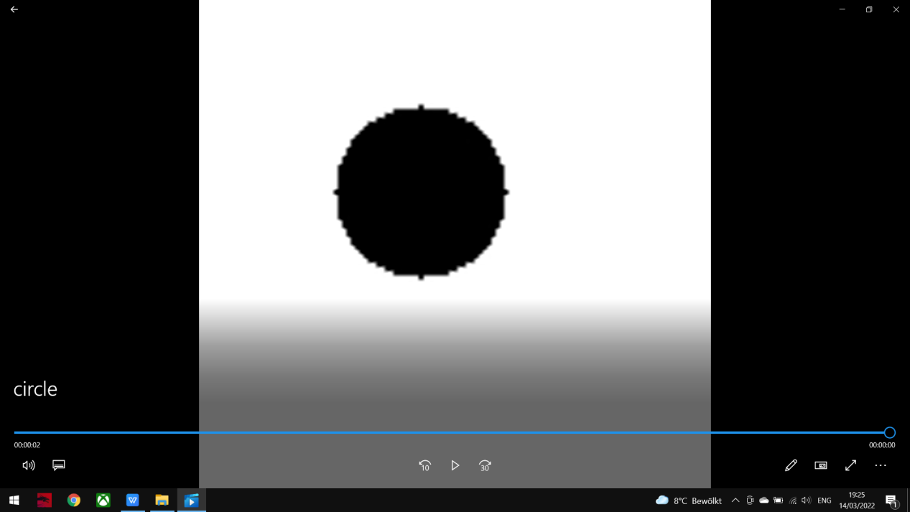
Simple Shape Videos

Slide 8
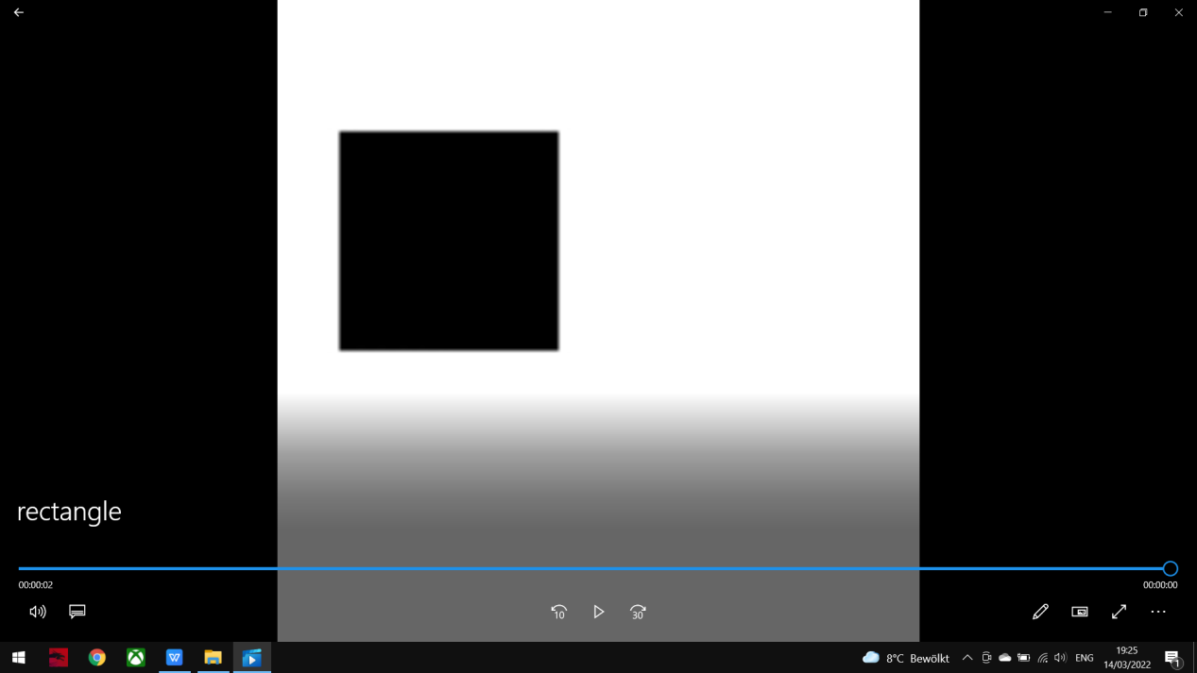
Simple Shape Videos

Slide 9
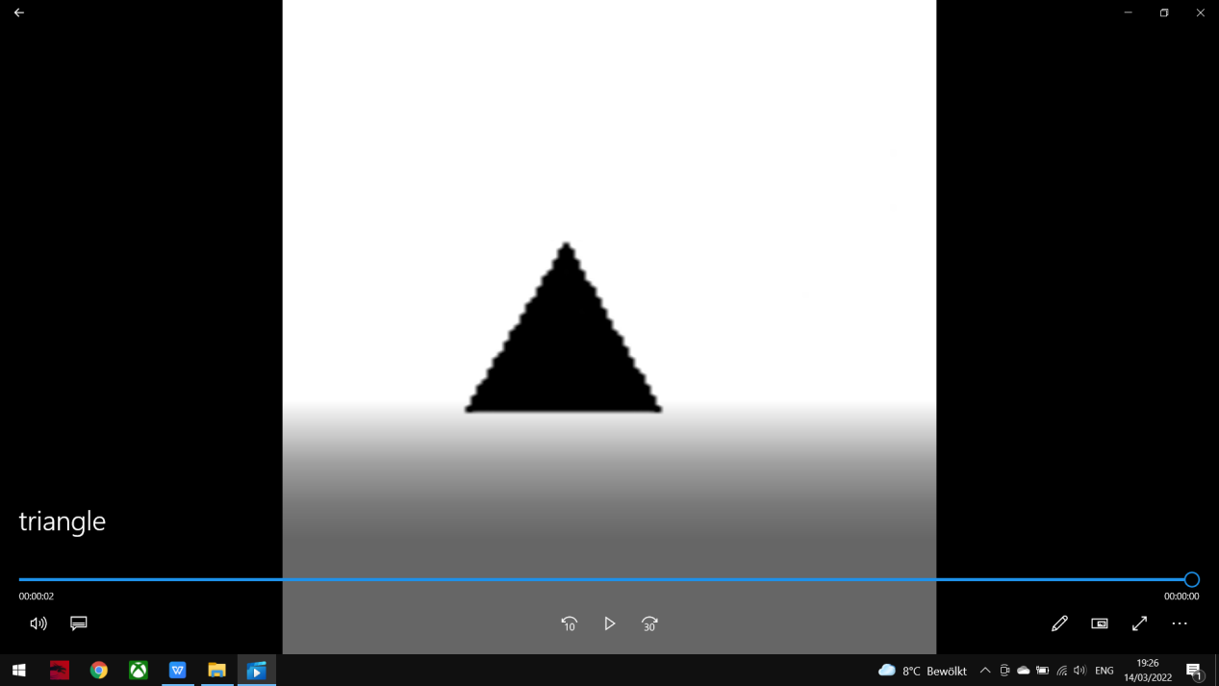
Simple Shape Videos

Slide 10
Methods
Providing an edited-version of a Youtube video, which is used as an input for the Video Learning
Test with different resolution configuration of the video (height, width)
->Test with Run1 and Run2
Test with various adjusted HTM configuration parameters, i.e Cells per Column, Max Boost, etc.
->Test with only Run2

Slide 11
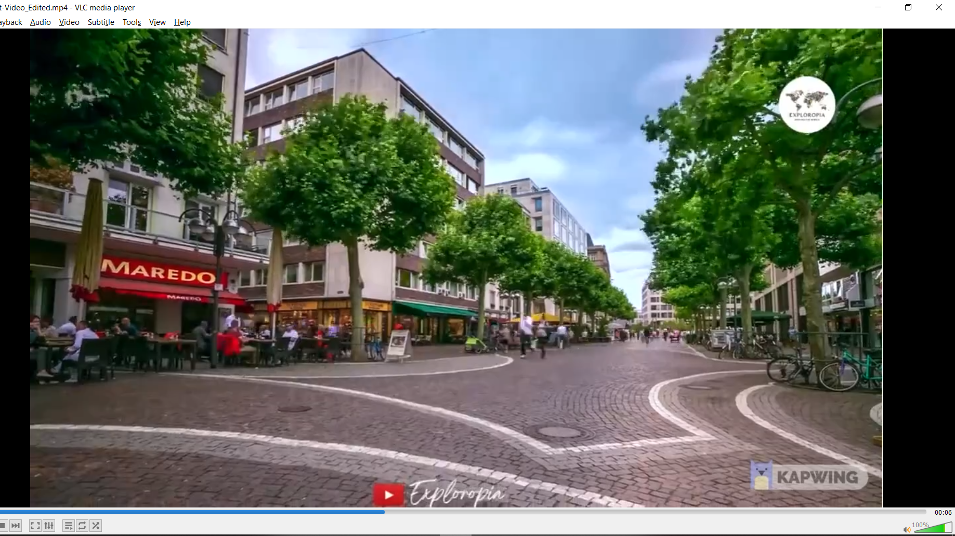
Frankfurt Video
An edited-to-5-seconds Collection of Drone & Aerial Footage video in Frankfurt.

Slide 12
Results
Satisfactory:
Average accuracy in general is approximately 65%
Lowest accuracy is 25%

Slide 13
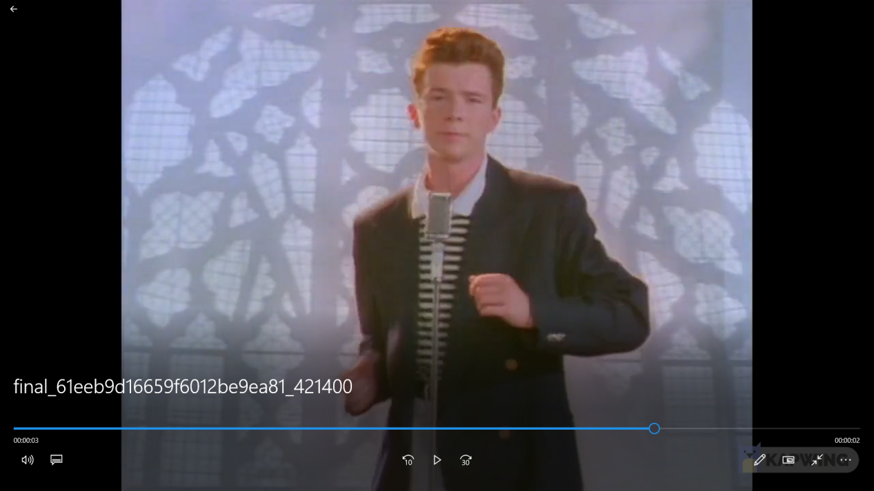
Youtube Video
An edited-to-5-seconds video from the MV “Never Gonna Give You Up” by Rick Astley

Slide 14
Results
Satisfactory:
Average accuracy in general is approximately 88%
Lowest accuracy is 81%
Some specific adjusted parameters in the HTM configuration result in exceptional accuracy, range from 90% to even 100%.

Slide 15
Discussions
Generally, the experiments produced satisfactory results.
Remarkably, several modifications in certain parameters results in exceptional accuracy values, some reached 0.99. The elapsed time for these experiments varies from 4 minutes to 46 minutes. Unconventionally, it is observed that high accuracy was not always accompanied by the long-elapsed time and vice versa.

